Slide 1

Autothon 2019
CTC TeaM Timisoara

Slide 2
CTC Team
Authoton
Easy to configure and attach to browser
Creates automated tests on the fly
Easy to configure CI/CD
Squish for Web Automation Framework
1
2
3
A less known but strong framework

Slide 3
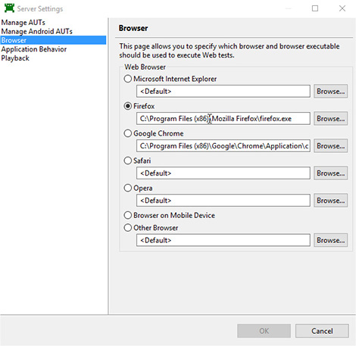

Squish performs automatically cross-platform tests
Creates and executes Web application tests across any of the following OS and Browser combinations*:
Linux, Unix, Mac and Windows
Firefox, Google Chrome, Safari, Internet Explorer, Mozilla, Opera and Mobile device
Note: If the Browser entry is not shown, please check which Squish package you are using as this entry is only visible in Squish for Web packages and combo packages including Squish for Web.

Slide 4
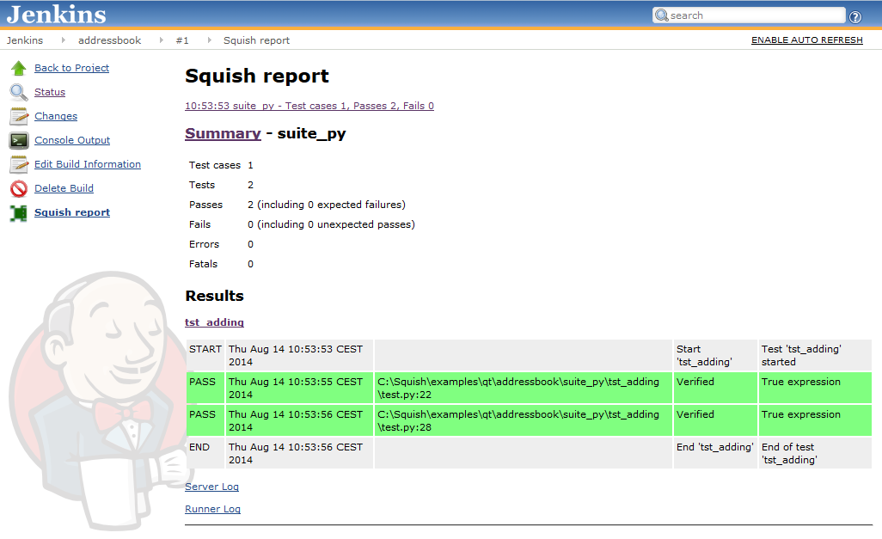
Squish integrates Jenkins
Continuous Integration (CI) tool.
Squish Plugin can be downloaded using the following URL: download.froglogic.com/resources/squish-jenkins-plugin_latest.zip. The minimum required Jenkins version for this plugin is Jenkins 2.60.3.
The Squish test results appear in Jenkins:

Slide 5

2
Test strategy
Squish bugs not scenarios

Slide 6
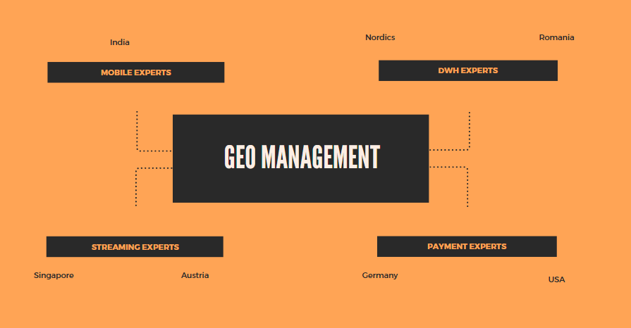
Test strategy solution
CTC TeaM

Slide 7
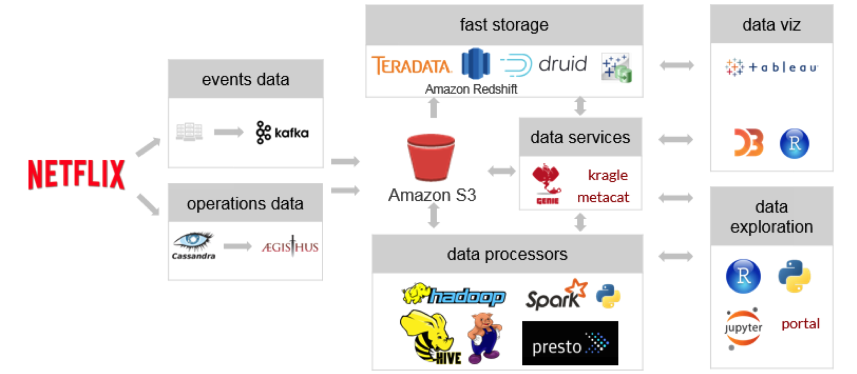
CTC TeaM
The data platform, shown here, is a complex but elegant system built on events and operational data fed into Amazon S3. Data is then sent, depending on end use, into Amazon Redshift or a series of NoSQL data processors that are then aggregated into Tableau Data Extracts.
This data lake/data warehouse strategy allows Netflix to collect and store massive amounts of data, but also provide a high level view of the data to analyze and explore. Of course, all of the data connections and extracts end up on Tableau Server, hosted on EC2.
Streaming infrastructure example

Slide 8
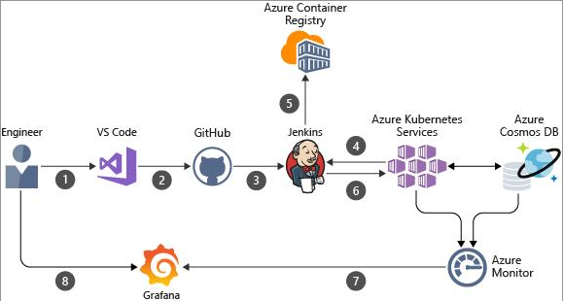
CTC TeaM
Movie Rental Service Architecture

Slide 9
CTC Team
Test strategy
Payment tests: https://www.testfairy.com https://cucumber.io/docs
DWH test: https://www.querysurge.com
Streaming test: https://www.seleniumhq.org/projects/webdriver/
Mobile tests: https://cucumber.io/docs http://appium.io/

Slide 10
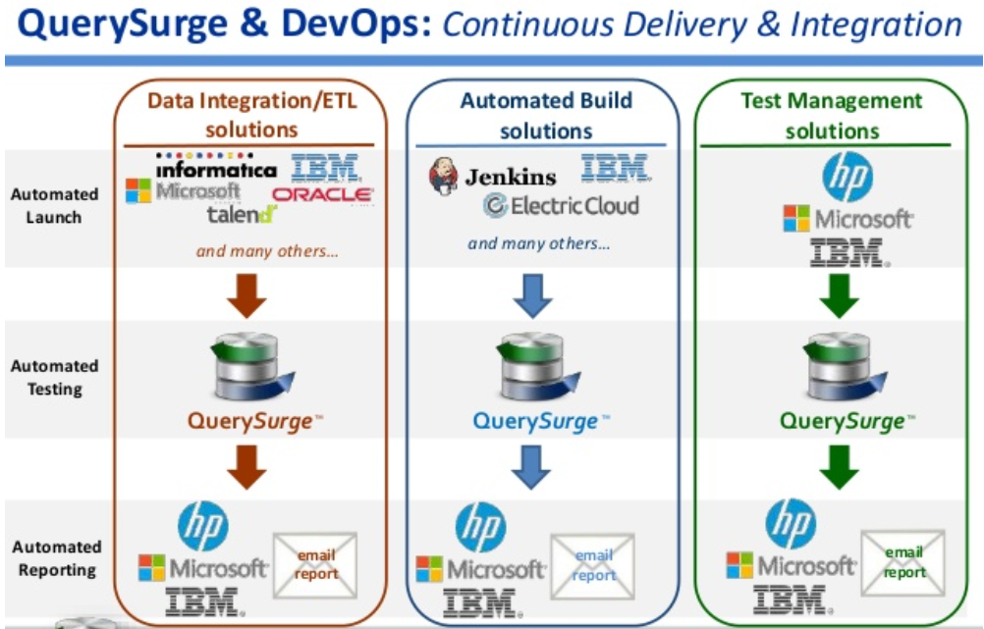
Movie Rental Service Architecture
DWH testing solution
Notes:
https://docspace.dlh.de/pages/viewpage.action?pageId=129823626&preview=%2F129823626%2F163172318%2FNetLine_Ops_Quality_Assurance.pptx

Slide 11
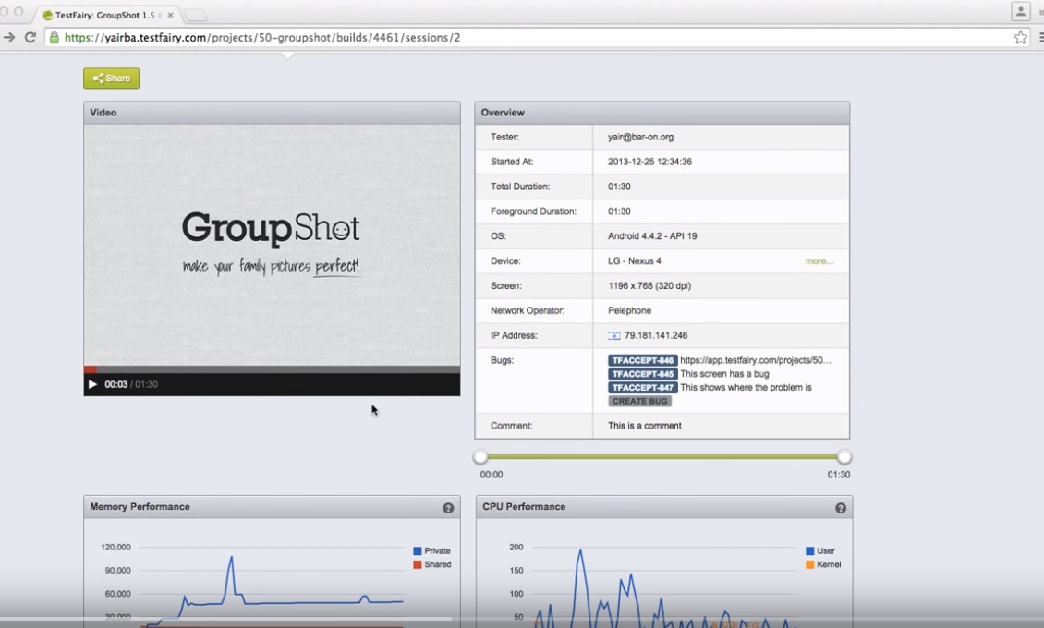
Movie Rental Service Architecture
Testing streaming with testfairy.com
Notes:
https://docspace.dlh.de/pages/viewpage.action?pageId=129823626&preview=%2F129823626%2F163172318%2FNetLine_Ops_Quality_Assurance.pptx

Slide 12
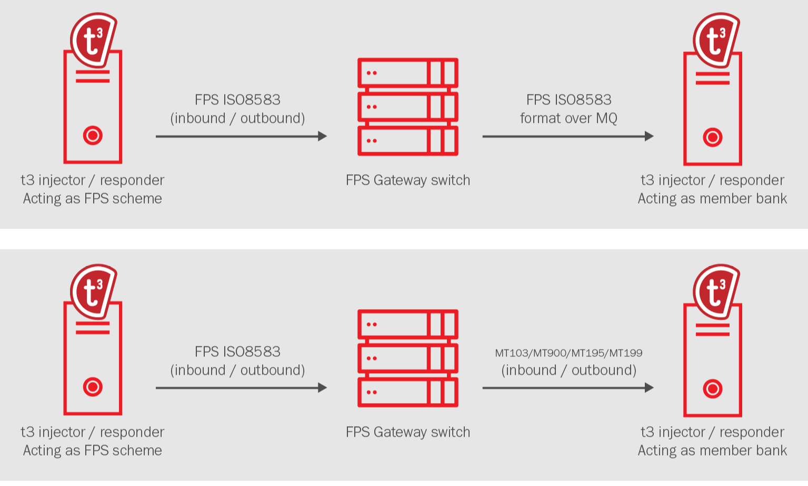
Movie Rental Service Architecture
Payment testing
Notes:
https://docspace.dlh.de/pages/viewpage.action?pageId=129823626&preview=%2F129823626%2F163172318%2FNetLine_Ops_Quality_Assurance.pptx

Slide 13
CTC Team
The software we used
https://doc.froglogic.com/squish/latest/tutorials-web.html
https://doc.froglogic.com/squish/latest/ao-hudson.html
https://www.getpostman.com/automated-testing
https://www.screenpresso.com
https://github.com/gerzse/CTC-TeaM

Slide 14
Quality favours the brave

